Slide 1
NeuroCuts - Neural Packet Classification
Classificador de Pacotes Neural
Autores: Eric Liang¹, Hang Zhu², Xin Jin², Ion Stoica¹
¹UC Berkeley, ²JHU
Discentes:
Eliton Luiz Scardin Perin
Jonathan Aldori Alves de Oliveira

Slide 2
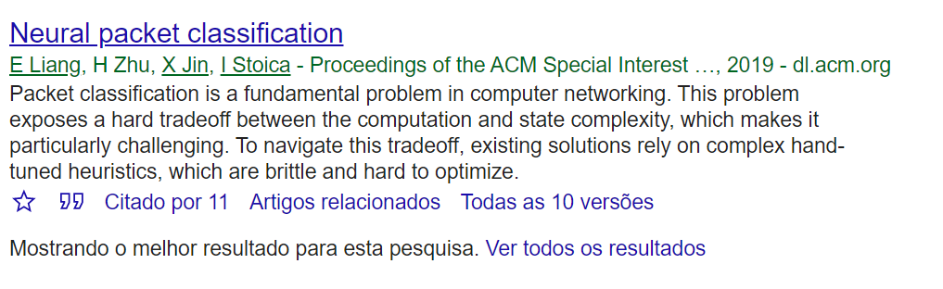
Trabalhos referenciados.
Encontramos 11 citações do trabalho.
Notes:
First we compare against other algorithms on classification time, tuning NeuroCuts rewards to minimize this.
X-axis is the classbench ruleset, here just acl1 to acl4 1k.
The Y axis shows the worst-case classification time (tree depth), lower is better.
NeuroCuts is shown in black.
As you can see NeuroCuts is able to generate trees significantly better than these algorithms.

Slide 3
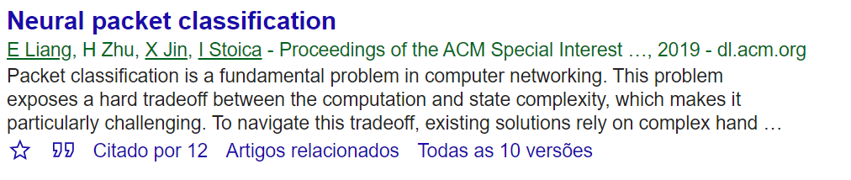
Trabalhos referenciados.
Apareceu uma nova citação do trabalho.
Notes:
First we compare against other algorithms on classification time, tuning NeuroCuts rewards to minimize this.
X-axis is the classbench ruleset, here just acl1 to acl4 1k.
The Y axis shows the worst-case classification time (tree depth), lower is better.
NeuroCuts is shown in black.
As you can see NeuroCuts is able to generate trees significantly better than these algorithms.

Slide 4
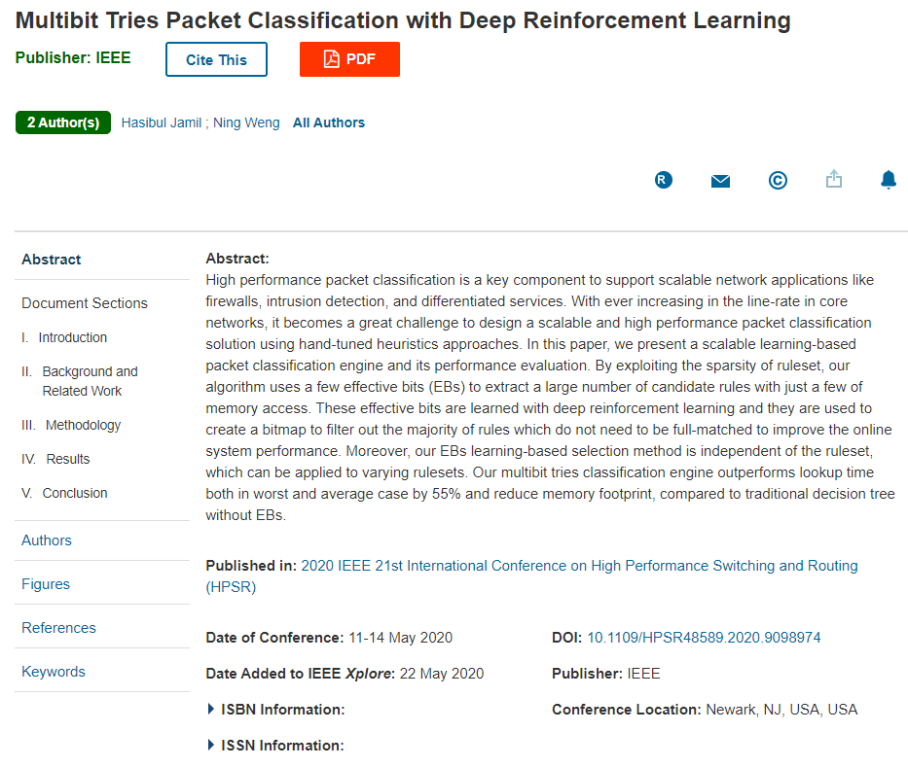
Trabalho referenciado.
Notes:
First we compare against other algorithms on classification time, tuning NeuroCuts rewards to minimize this.
X-axis is the classbench ruleset, here just acl1 to acl4 1k.
The Y axis shows the worst-case classification time (tree depth), lower is better.
NeuroCuts is shown in black.
As you can see NeuroCuts is able to generate trees significantly better than these algorithms.

Slide 5
Trabalho referenciado.
Multibit Tries Packet Classification with Deep Reinforcement Learning
Neste artigo, apresentamos um mecanismo de classificação de pacotes escalável baseado em aprendizado e sua avaliação de desempenho. Ao explorar a esparsidade do conjunto de regras, nosso algoritmo usa alguns bits efetivos (EBs) para extrair um grande número de regras candidatas com apenas alguns acessos à memória. Esses bits efetivos são aprendidos com o aprendizado por reforço profundo e são usados ​​para criar um bitmap para filtrar a maioria das regras que não precisam ser compatíveis para melhorar o desempenho do sistema online. Além disso, nosso método de seleção baseado em aprendizado de EBs é independente do conjunto de regras, que pode ser aplicado a diferentes conjuntos de regras. Nosso mecanismo de classificação de tentativas multibits supera o tempo de pesquisa nos pior casos e no caso médio em 55% e reduz a pegada de memória em comparação com a árvore de decisão tradicional sem Ebs.
Notes:
First we compare against other algorithms on classification time, tuning NeuroCuts rewards to minimize this.
X-axis is the classbench ruleset, here just acl1 to acl4 1k.
The Y axis shows the worst-case classification time (tree depth), lower is better.
NeuroCuts is shown in black.
As you can see NeuroCuts is able to generate trees significantly better than these algorithms.

Slide 6
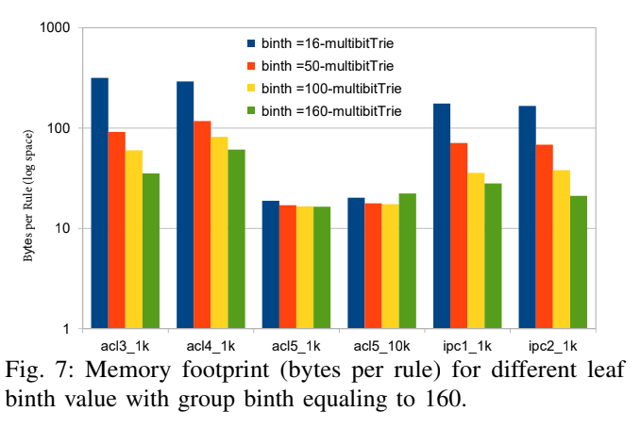
Trabalho referenciado.
Multibit Tries Packet Classification with Deep Reinforcement Learning
Notes:
First we compare against other algorithms on classification time, tuning NeuroCuts rewards to minimize this.
X-axis is the classbench ruleset, here just acl1 to acl4 1k.
The Y axis shows the worst-case classification time (tree depth), lower is better.
NeuroCuts is shown in black.
As you can see NeuroCuts is able to generate trees significantly better than these algorithms.

Slide 7
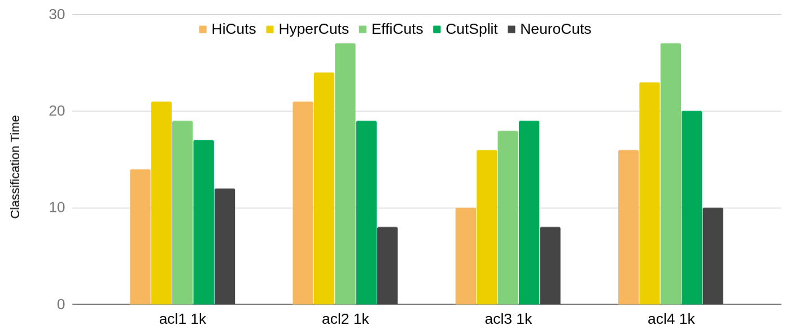
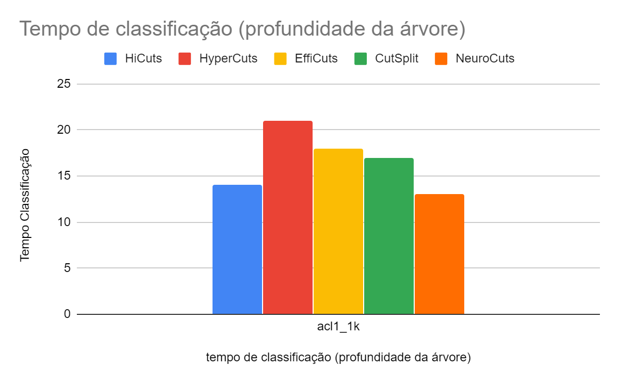
NeuroCuts com otimização de tempo
Classification time
Classifier name
Notes:
First we compare against other algorithms on classification time, tuning NeuroCuts rewards to minimize this.
X-axis is the classbench ruleset, here just acl1 to acl4 1k.
The Y axis shows the worst-case classification time (tree depth), lower is better.
NeuroCuts is shown in black.
As you can see NeuroCuts is able to generate trees significantly better than these algorithms.

Slide 8
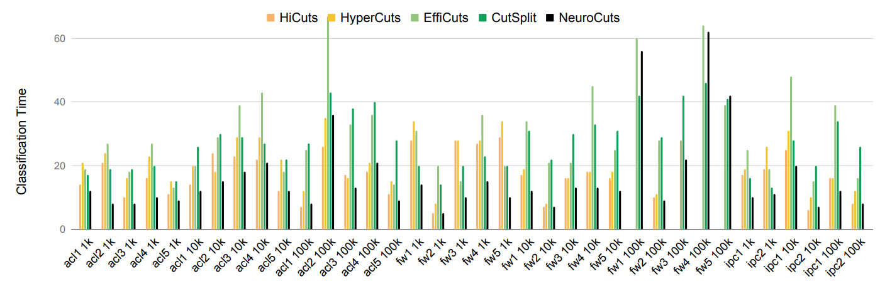
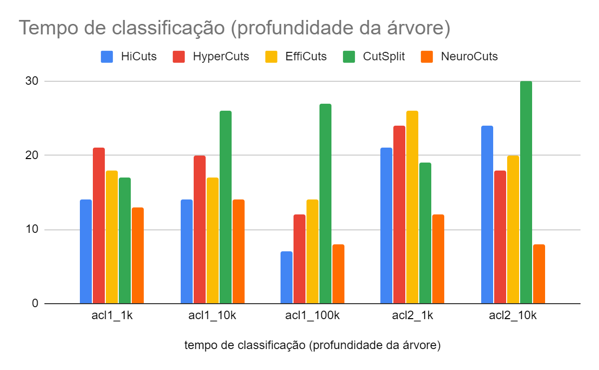
NeuroCuts com otimização de tempo: ele é escalável?
Summary: 18% median time improvement over all baselines. Up to 2x better.
Notes:
Does it scale? Yes. Her we compare against the full classsbench dataset with up to 100k rules.

Slide 9
Próximos passos
Tentar encontrar um melhor trade-off do coeficiente e usar durante o treinamento para se autoajustar ..( tempo de classificação -“profundidade das árvore” e no uso de memória – “bytes por regra”).
Outras heurísticas.
Obrigado!
Notes:
In the future we think Neurocuts

